Slide 1
Ch. 21: Fundamentals of HTML

Slide 2
CSS Concepts Covered Today
Connect CSS page to HTML page
Background
Font-family: font names here separated by commas
Font-size: can be specified in terms of pt or px or em
Font-weight: can be specified as a word “bold” or a number “900”
Color: can be specified as a word “red” or a hexadecimal code “#3FG670”
Text-align: right, left, center, or justify
Text-decoration: overline, line-through, underline, none
Box model properties:
Padding: clears an area around the content area
Border: goes around the padding and content. To make the border visible, you must define the “border-style” property.
Margin: clears an area around the border. Margins have no background color and are always transparent.

Slide 3
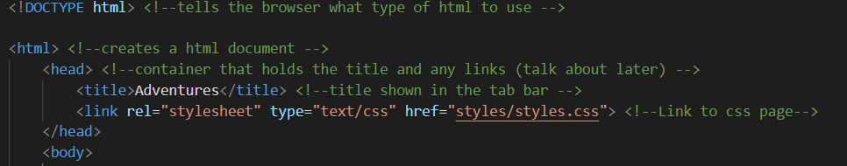
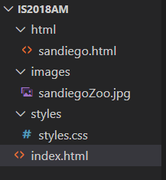
Connect CSS to HTML

Slide 4
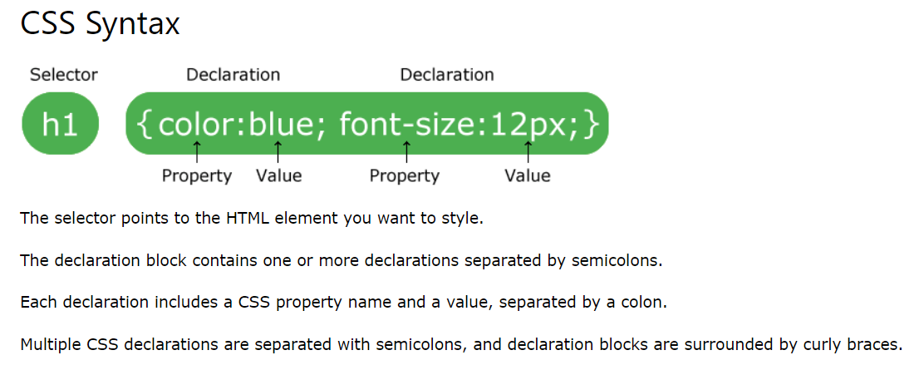

Slide 5
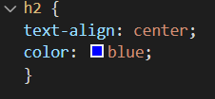
Element Selector
Selects HTML elements based on the elements name
All ‘h2’ elements will be centered aligned and blue

Slide 6

Id Selector
CSS Page
An id in HTML is used to select a specific unique element
Write a hash (#) before the id
This will make the id of ‘top’ red.
HTML Page

Slide 7
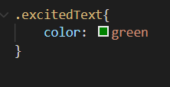
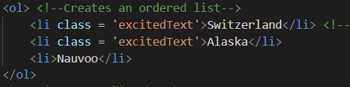
Class Selector
CSS Page
References a class. A class can be used multiple times
Write a period (.) before the id
This will make the class of ‘excitedText’ green
HTML Page

Slide 8
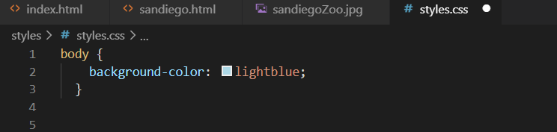
Background
Makes the background color light blue.
See W3 schools for more info

Slide 9

Font Family
Font names here separated by commas. List multiple fonts as backup.
See W3 schools for more info

Slide 10
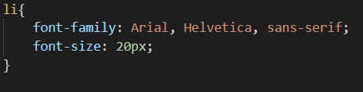
Font Size
Font-size: can be specified in terms of px or em
1em is equal to the current font size. The default text size in browsers is 16px. So, the default size of 1em is 16px.
The size can be calculated from pixels to em using this formula: pixels/16=em
See W3 schools for more info

Slide 11
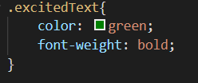
Font Color
Can be specified as a word “red” or a hexadecimal code “#3FG670”
See W3 schools for more info

Slide 12
Text-align
Right, left, center or justify
See W3 schools for more info

Slide 13
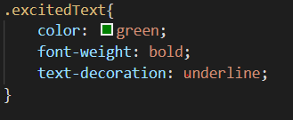
Text-decoration
Overline, line-through, underline, none
See W3 schools for more info

Slide 14
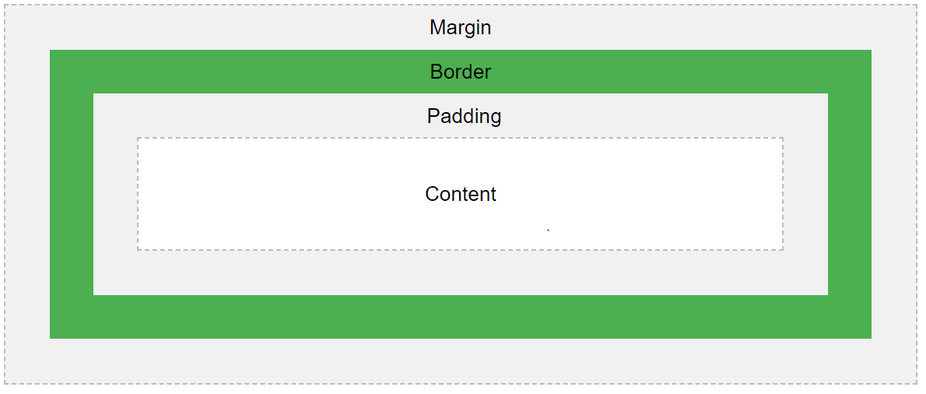
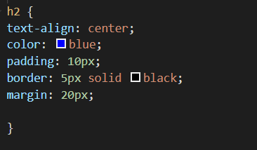
Box Model
Explanation of the different parts:
Content - The content of the box, where text and images appear
Padding - Clears an area around the content. The padding is transparent
Border - A border that goes around the padding and content
Margin - Clears an area outside the border. The margin is transparent
The box model allows us to add a border around elements, and to define space between elements.
See W3 schools for more info

